Slide 1
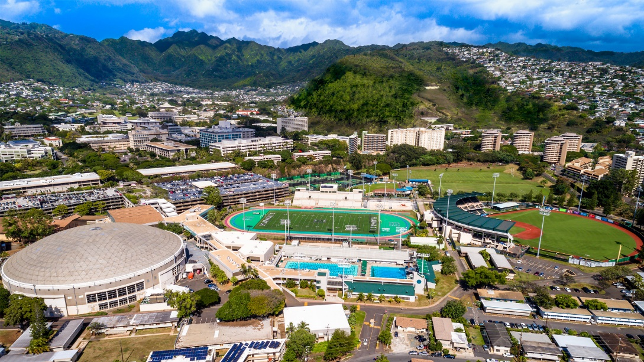
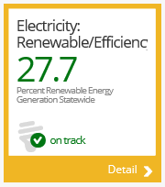
Problem Statement
UHM spends $30M /yr on Electricity!
Use as as much energy as the entire Manoa valley.
Is this normal? Where is it going?
Can we reduce it?

Slide 2
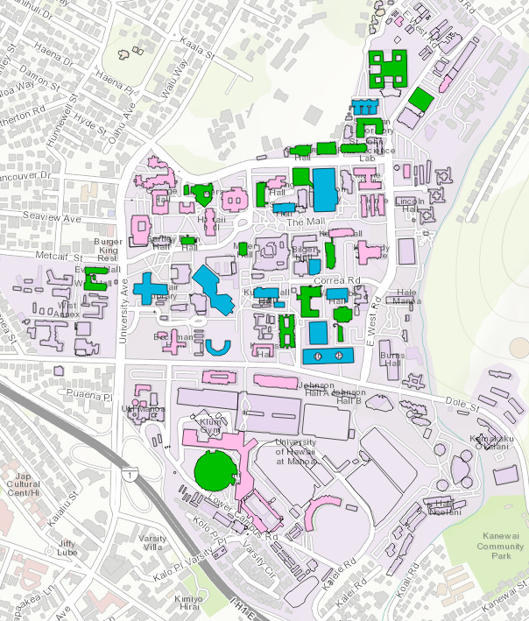
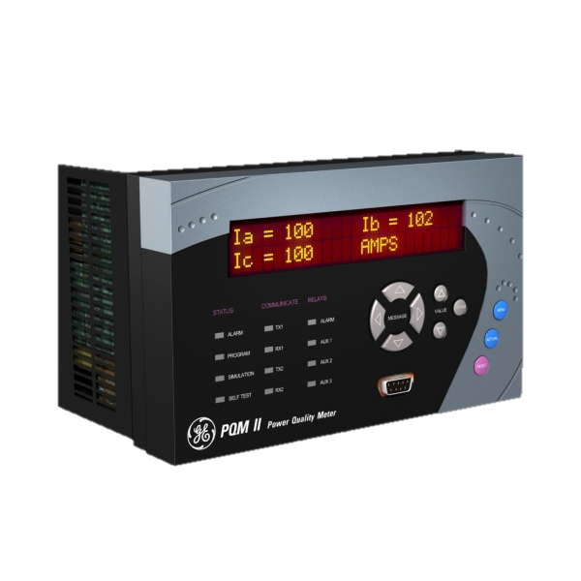

UHM Smart metering
33 buildings online
65 more buildings in progress 2017-18
Phase 1 meters
University of Hawai‘i | Office of Sustainability

Slide 3














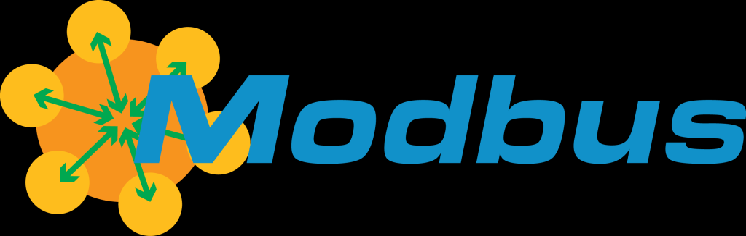



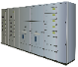
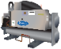
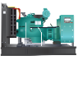
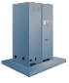

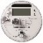
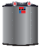
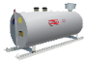
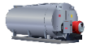
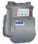
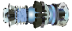
Aurora Database
Proof Points
Thousands of assets connected
Hundreds of megawatts
Deployed 75% faster, 30% more affordably
No stranded assets
Utility Back Office
Operations and Energy Management System
3rd Party Connectivity
Demand-side Management
Distribution Management System
Distributed Energy Management System
Cloud & Multi Site Services
Macro Orchestration
Analytics & Forecasting
Data Federation
Common Interfaces
Market Integration
Dashboard
SCADA
Local SCADA Dashboard and UI
Web Configurator User Interface
Integration Services
Storage & Logging Manager
Event Manager
Alarm Manager
Data Access
Platform
Example Customers
Web Hosting Services
Processes
Device Connectivity
Asset Listing
Configuration Server
Equipment Library
Data Access
Local Storage
Survey
Asset Location
Asset Type
Aurora Gateway
Aurora Gateway
Aurora Gateway
Aurora Gateway
Aurora Gateway
SNMP
Connectivity
Aurora Retrofit & Smart Module
Microgrid Controls
MDMS
SCADA
BAS
Legacy Systems
ICCP (IEC 60870-6)
Equipment
eIOT

Slide 4
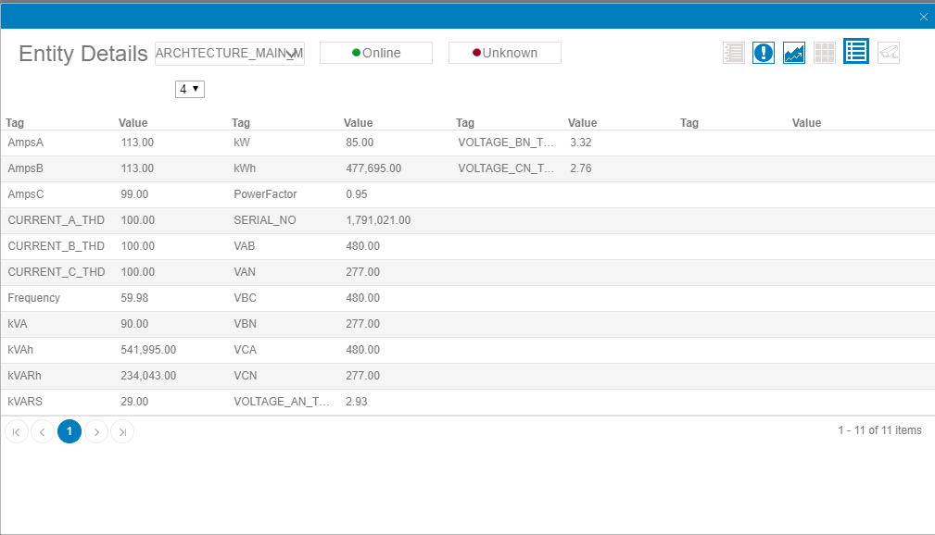
Several Points Availible

Slide 5
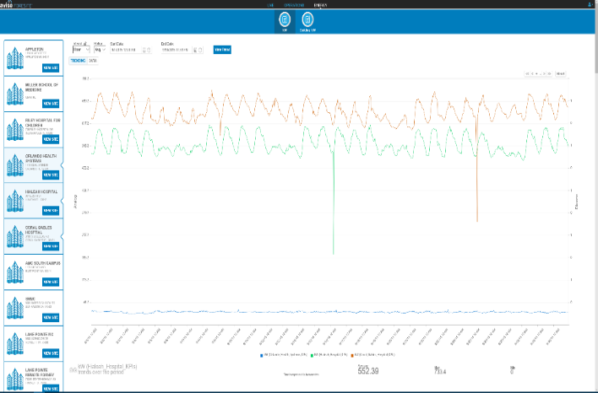

BIG Data Solutions
Aurora database 1-min interval data from the buildings across campus.
Collecting for about 2 years. Large data set.
BIG data to be exploited to help identify solutions and future projects.

Slide 6


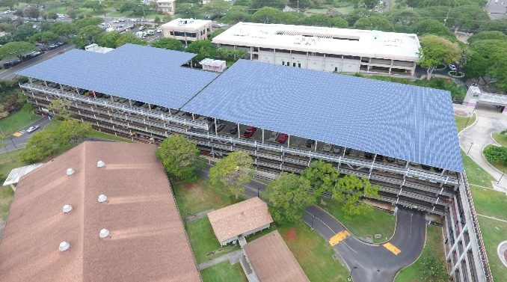

Outputs
Big data analytics, and software to inform decision makers to take action.
Data
Information
Action

Slide 7

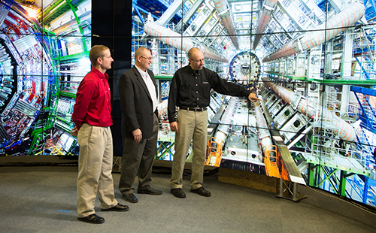
Possible HACC projects
An analysis or an analysis tool
Historical Trending, Predictive Analysis
Data Visualizations
Dashboards, Heat maps
AR, VR, Cyber Canoe
Fused data streams
Kwh/sqft
kwh/enrollment
kWh/research/degree day/$$/GHG

Slide 8
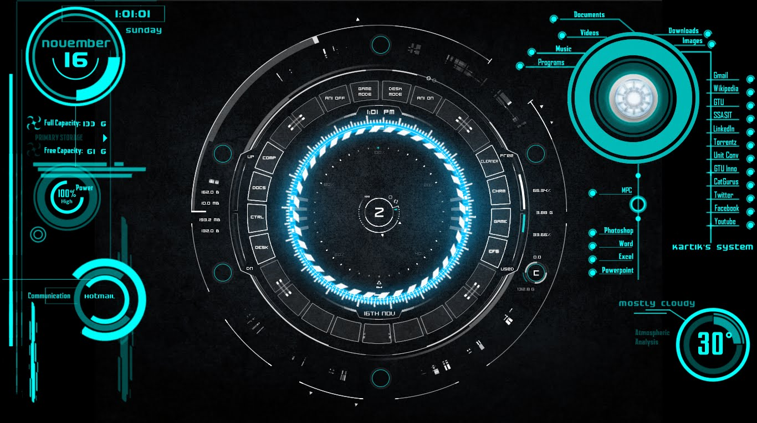
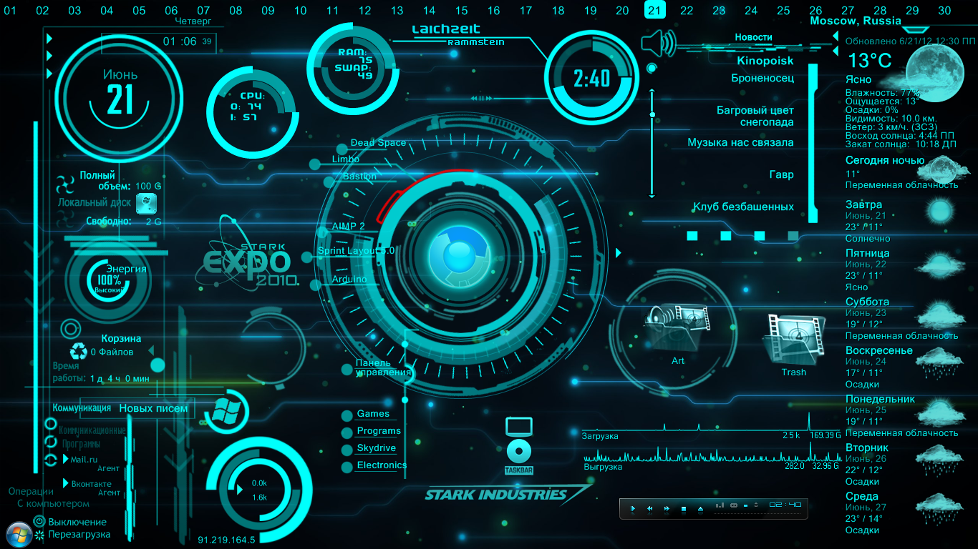
Mahalo
Please accept this challenge

